Slide 1

Distribution of Xenopsylla cheopis and Monitoring of Insecticide Resistance
Chembars, MS
Research Methods II Seminar

Slide 2
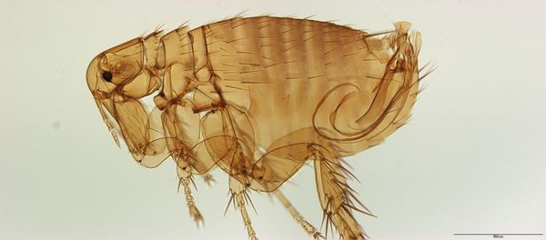
Who cares?
Plague is one of the deadliest diseases caused by Yersinia pestis
Vectored by many flea species in North America
Most recent outbreak in Madagascar killed 200+ people (20% fatality)
Foci exist in many parts of the world
More surveillance needed
Little known about distribution and insecticide resistance status in US
Notes:
I want to see if there is higher insecticide resistance in fleas living in urban areas versus rural areas due to insecticide spraying in urban environments.
I also want to see if passive transport may be mediating this insecticide resistance status in fleas, so I will be sampling from four sites for this demonstration: urban highway, urban, rural highway, rural.

Slide 3

Packages
leaflet
leaflet.extras
htmlwidgets
ggplot2
dplyr
Notes:
These are the packages I used.
Leaflet and leaflet.extras were used to generate the map I am about to show you. Leaflet uses a Javascript library and the openstreetmap (OSM) tiles, while leaflet.extras and htmlwidgets allows me to generate popups for my individual data points.
Ggplot2, used to make the extremely rudimentary bar chart I’ll show later with some expected data
Dplyr is used to calculate the prevalence of KDR mutation in the rural vs urban environments.

Slide 4
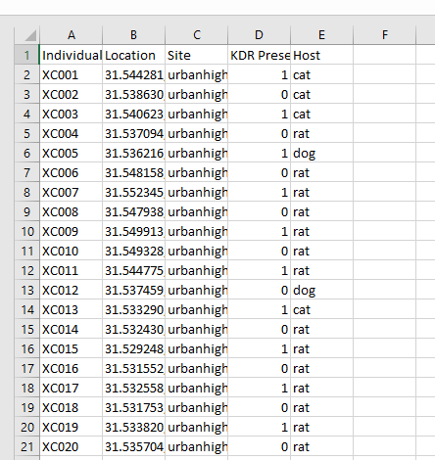
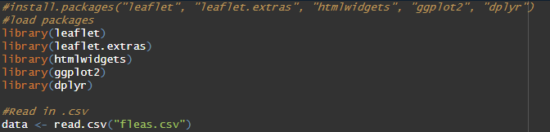
Data Set
Notes:
So first, we have to install and load the packages. Then we read in the csv and assign it to a data frame named ‘data’.
On the left is an example of how the data is organized. Very basic. Individuals named from XC001 to XC80 (20 fleas per site)
Location is the next column, with x and y coordinates.
Four sites are urban near highway, urban, rural near highway, and rural.
Next, assuming we performed molecular analysis confirming the presence or absence of a mutation at the KDR locus in each of these individuals. I used binary functions to assign whether there is or is not a presence, with 0 meaning there is no mutation, and 1 meaning there is a mutation.
Last column is showing the type of host the flea was recovered from.

Slide 5
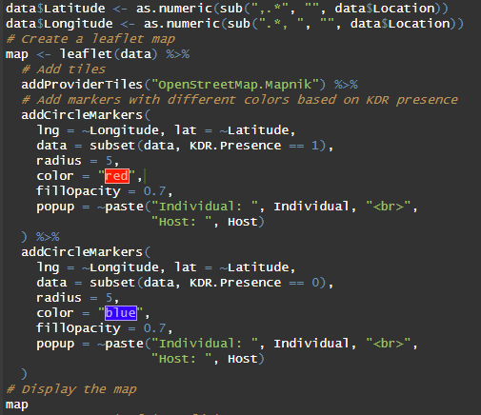
Generate the map
Notes:
First we split the location column into latitude and longitude columns
Then we create a map using the leaflet package, again using the Openstreetmap data for the map tiles.
The next two steps are for including different colored data points on our interactive map. The red dots will represent fleas sampled that are positive for a mutation in the KDR locus, again indicated by the binary 1
Then, the blue dots represent fleas sampled that are negative for a mutation in the KDR locus, again indicated by the binary 0
And when one clicks on any of the data points, I also specified that it shows both the individual’s ID, and the host it originated from.
And then to display the map, just run ‘map’

Slide 6
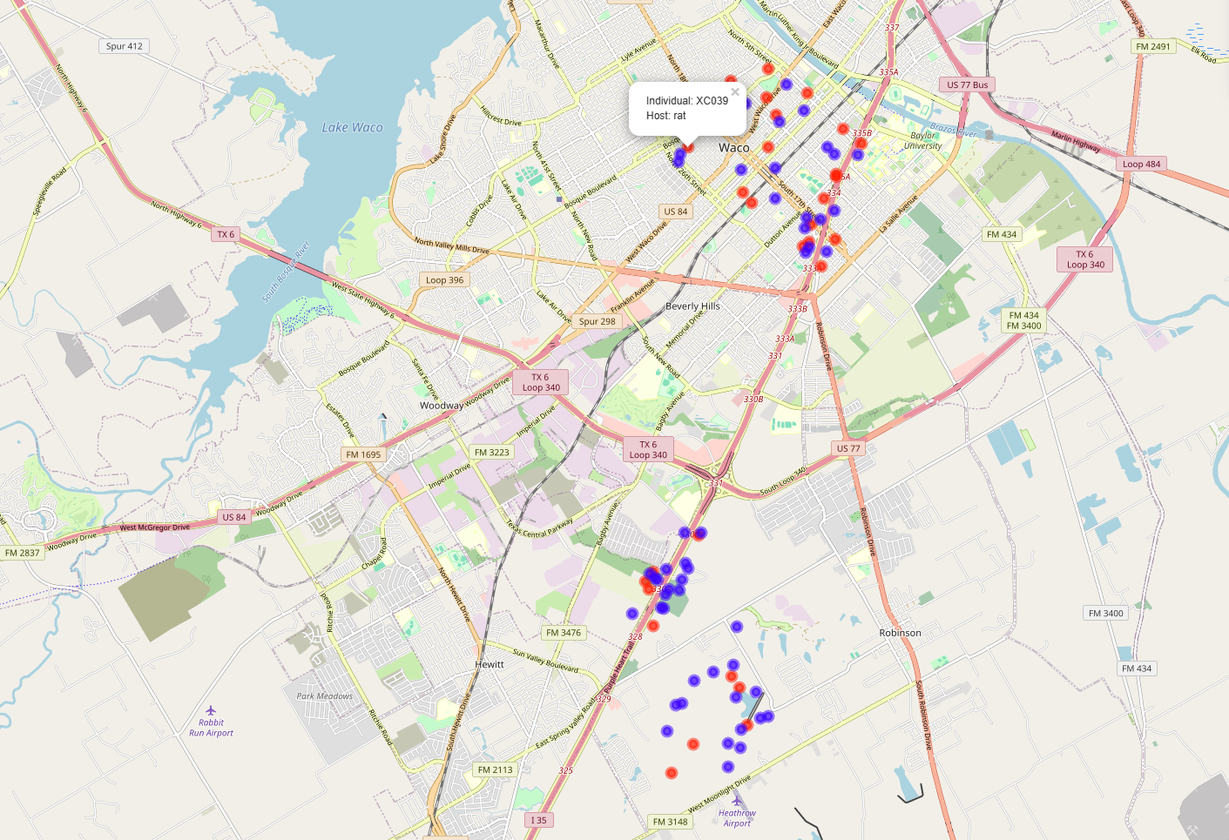
Save Map as .html
Notes:
Here is the map generated. So what this fake data is suggesting through the eyeball test, is that there is a significantly higher proportion of KDR mutations in urban fleas, but that there is no difference between fleas found near or far from the highway, which might eliminate the role of passive transport in insecticide resistance.
Again, this is entirely fake data, and I have absolutely no idea what I will actually see once I do this.

Slide 7
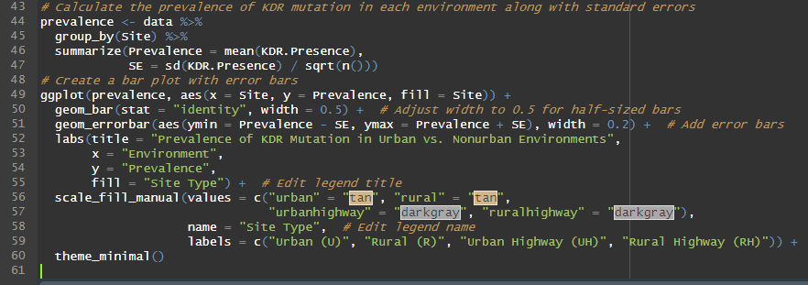
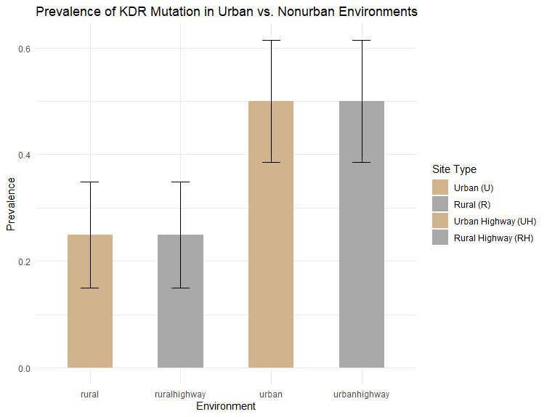
Visualization
Notes:
I then calculated the prevalence of the KDR mutation in each of the four environments, and also calculated the standard errors.
Then, I created a bar plot with error bars.
Once again, this is a perfect data set with zero anomalies whatsoever, but this is just an example of the kind of data I could generate once I get funding.

Slide 8
Questions?
Be nice :P

